Slide 1
Cache coherence
CEG 4131 Computer Architecture III
Slides developed by Dr. Hesham El-Rewini
Copyright Hesham El-Rewini

Slide 2
Single Processor caching
Hit: data in the cache
Miss: data is not in the cache
x
Memory
x
Cache
Hit rate: h
Miss rate: m = (1-h)
P

Slide 3
Cache Coherence Policies
Writing to Cache in 1 processor case
  Write Through
  Write Back

Slide 4
Writing in the cache
x
Memory
x’
Memory
x
Memory
x
Cache
x’
Cache
x’
Cache
P
P
P
Before
Write through
Write back

Slide 5
Cache Coherence
x
x
x
x
P1
P2
P3
Pn
Multiple copies of x
What if P1 updates x?

Slide 6
Cache Coherence Policies
Writing to Cache in n processor case
  Write Update - Write Through
  Write Invalidate - Write Back
  Write Update - Write Back
  Write Invalidate - Write Through

Slide 7
Write-invalidate
x
x’
x
x
x
x’
I
x’
I
P1
P2
P3
P1
P2
P3
P1
P2
P3
Before
Write Through
Write back

Slide 8
Write-Update
x
x’
x
x
x
x’
x’
x’
x’
P1
P2
P3
P1
P2
P3
P1
P2
P3
Before
Write Through
Write back

Slide 9
Snooping Protocols
Snooping protocols are based on watching bus activities and carry out the appropriate coherency commands when necessary. Global memory is moved in blocks, and each block has a state associated with it, which determines what happens to the entire contents of the block. The state of a block might change as a result of the operations Read-Miss, Read-Hit, Write-Miss, and Write-Hit.

Slide 10
Write Invalidate Write Through
Multiple processors can read block copies from main memory safely until one processor updates its copy. At this time, all cache copies are invalidated and the memory is updated to remain consistent.

Slide 11
Write Through- Write Invalidate (cont.)
State
Description
Valid
[VALID]
The copy is consistent with global memory
Invalid
[INV]
The copy is inconsistent

Slide 12
Write Through- Write Invalidate (cont.)
Event
Actions
Read Hit
Use the local copy from the cache.
Read Miss
Fetch a copy from global memory. Set the state of this copy to Valid.
Write Hit
Perform the write locally. Broadcast an Invalid command to all caches. Update the global memory.
Write Miss
Get a copy from global memory. Broadcast an invalid command to all caches. Update the global memory. Update the local copy and set its state to Valid.
Replace
Since memory is always consistent, no write back is needed when a block is replaced.

Slide 13
Example 1
X = 5
P reads X
Q reads X
Q updates X, X=10
Q reads X
Q updates X, X=15
P updates X, X=20
Q reads X
M
C
C
P
Q

Slide 14
Write through write invalidate
Complete the table
Memory
P’s
Cache
Q’s
Cache
Event
X
X
State
X
State
0
Original value
5
1
P reads X
(Read Miss)
5
5
VALID

Slide 15
Write Back- Write Invalidate (ownership)
A valid block can be owned by memory and shared in multiple caches that can contain only the shared copies of the block. Multiple processors can safely read these blocks from their caches until one processor updates its copy. At this time, the writer becomes the only owner of the valid block and all other copies are invalidated.

Slide 16
Write Back- Write Invalidate (cont.)
State
Description
Shared
(Read-Only) [RO]
Data is valid and can be read safely. Multiple copies can be in this state
Exclusive
(Read-Write) [RW]
Only one valid cache copy exists and can be read from and written to safely. Copies in other caches are invalid
Invalid
[INV]
The copy is inconsistent

Slide 17
Ownership (cont.)
Event
Action
Read Hit
Use the local copy from the cache.
Read Miss:
If no Exclusive (Read-Write) copy exists, then supply a copy from global memory. Set the state of this copy to Shared (Read-Only). If an Exclusive (Read-Write) copy exists, make a copy from the cache that set the state to Exclusive (Read-Write), update global memory and local cache with the copy. Set the state to Shared (Read-Only) in both caches.

Slide 18
Ownership (cont.)
Write Hit
If the copy is Exclusive (Read-Write), perform the write locally. If the state is Shared (Read-Only), then broadcast an Invalid to all caches. Set the state to Exclusive (Read-Write).
Write Miss
Get a copy from either a cache with an Exclusive (Read-Write) copy, or from global memory itself. Broadcast an Invalid command to all caches. Update the local copy and set its state to Exclusive (Read-Write).
Block Replacement
If a copy is in an Exclusive (Read-Write) state, it has to be written back to main memory if the block is being replaced. If the copy is in Invalid or Shared (Read-Only) states, no write back is needed when a block is replaced.

Slide 19
Example –2
Complete the table (Ownership)
Memory
P’s
Cache
Q’s
Cache
Event
X
X
State
X
State
0
Original value
5
1
P reads X
(Read Miss)
5
5
RO

Slide 20
Write Once
This write-invalidate protocol, which was proposed by Goodman in 1983 uses a combination of write-through and write-back. Write-through is used the very first time a block is written. Subsequent writes are performed using write back.

Slide 21
Write Once (cont.)
State
Description
Invalid
[INV]
The copy is inconsistent.
Valid
[VALID]
The copy is consistent with global memory.
Reserved
[RES]
Data has been written exactly once and the copy is consistent with global memory. There is only one copy of the global memory block in one local cache.
Dirty
[DIRTY]
Data has been updated more than once and there is only one copy in one local cache. When a copy is dirty, it must be written back to global memory

Slide 22
Write Once (Cont.)
Event
Actions
Read Hit
Use the local copy from the cache.
Read Miss
If no Dirty copy exists, then supply a copy from global memory. Set the state of this copy to Valid. If a dirty copy exists, make a copy from the cache that set the state to Dirty, update global memory and local cache with the copy. Set the state to VALID in both caches.

Slide 23
Write Once (Cont.)
Write Hit
If the copy is Dirty or Reserved, perform the write locally, and set the state to Dirty. If the state is Valid, then broadcast an Invalid command to all caches. Update the global memory and set the state to Reserved.
Write Miss
Get a copy from either a cache with a Dirty copy or from global memory itself. Broadcast an Invalid command to all caches. Update the local copy and set its state to Dirty.
Block Replacement
If a copy is in a Dirty state, it has to be written back to main memory if the block is being replaced. If the copy is in Valid, Reserved, or Invalid states, no write back is needed when a block is replaced.

Slide 24
Write update and partial write through
In this protocol an update to one cache is written to memory at the same time it is broadcast to other caches sharing the updated block. These caches snoop on the bus and perform updates to their local copies. There is also a special bus line, which is asserted to indicate that at least one other cache is sharing the block.

Slide 25
Write update and partial write through (cont.)
State
Description
Valid Exclusive
[VAL-X]
This is the only cache copy and is consistent with global memory
Shared
[SHARE]
There are multiple caches copies shared. All copies are consistent with memory
Dirty
[DIRTY]
This copy is not shared by other caches and has been updated. It is not consistent with global memory. (Copy ownership)

Slide 26
Write update and partial write through (cont.)
Event
Action
Read Hit
Use the local copy from the cache. State does not change
Read Miss:
If no other cache copy exists, then supply a copy from global memory. Set the state of this copy to Valid Exclusive. If a cache copy exists, make a copy from the cache. Set the state to Shared in both caches. If the cache copy was in a Dirty state, the value must also be written to memory.

Slide 27
Write update and partial write through (cont.)
Write Hit
Perform the write locally and set the state to Dirty. If the state is Shared, then broadcast data to memory and to all caches and set the state to Shared. If other caches no longer share the block, the state changes from Shared to Valid Exclusion.
Write Miss
The block copy comes from either another cache or from global memory. If the block comes from another cache, perform the update and update all other caches that share the block and global memory. Set the state to Shared. If the copy comes from memory, perform the write and set the state to Dirty.
Block Replacement
If a copy is in a Dirty state, it has to be written back to main memory if the block is being replaced. If the copy is in Valid Exclusive or Shared states, no write back is needed when a block is replaced.

Slide 28
Write Update Write Back
This protocol is similar to the pervious one except that instead of writing through to the memory whenever a shared block is updated, memory updates are done only when the block is being replaced.

Slide 29
Write Update Write Back (cont.)
State
Description
Valid Exclusive
[VAL-X]
This is the only cache copy and is consistent with global memory
Shared Clean
[SH-CLN]
There are multiple caches copies shared.
Shared Dirty
[SH-DRT]
There are multiple shared caches copies. This is the last one being updated. (Ownership)
Dirty
[DIRTY]
This copy is not shared by other caches and has been updated. It is not consistent with global memory. (Ownership)

Slide 30
Write Update Write Back (cont.)
Event
Action
Read Hit
Use the local copy from the cache. State does not change
Read Miss:
If no other cache copy exists, then supply a copy from global memory. Set the state of this copy to Valid Exclusive. If a cache copy exists, make a copy from the cache. Set the state to Shared Clean. If the supplying cache copy was in a Valid Exclusion or Shared Clean, its new state becomes Shared Clean. If the supplying cache copy was in a Dirty or Shared Dirty state, its new state becomes Shared Dirty.

Slide 31
Write Update Write Back (cont.)
Write Hit
If the sate was Valid Exclusive or Dirty, Perform the write locally and set the state to Dirty. If the state is Shared Clean or Shared Dirty, perform update and change state to Shared Dirty. Broadcast the updated block to all other caches. These caches snoop the bus and update their copies and set their state to Shared Clean.
Write Miss
The block copy comes from either another cache or from global memory. If the block comes from another cache, perform the update, set the state to Shared Dirty, and broadcast the updated block to all other caches. Other caches snoop the bus, update their copies, and change their state to Shared Clean. If the copy comes from memory, perform the write and set the state to Dirty.
Block Replacement
If a copy is in a Dirty or Shared Dirty state, it has to be written back to main memory if the block is being replaced. If the copy is in Valid Exclusive, no write back is needed when a block is replaced.

Slide 32
Directory Based Protocols
Due to the nature of some interconnection networks and the size of the shared memory system, updating or invalidating caches using snoopy protocols might become unpractical .
Examples??
Cache coherence protocols that somehow store information on where copies of blocks reside are called directory schemes.
Notes:
Broadcast-based protocols resort to broadcasting messages for coherence actions using a “snooping” bus. These protocols are not scalable to large multiprocessor systems because coherence messages use a lot of bus bandwidth when multiple processors are sharing the same data. However, directory-based protocols use hardware to keep track of which processors are sharing each block of data and are therefore more scalable than broadcast-based protocols.

Slide 33
What is a directory?
A directory is a data structure that maintains information on the processors that share a memory block and on its state. The information maintained in the directory could be either centralized or distributed.
Notes:
A directory is a list storing the location of all shared copies of each shared blocks of data. A directory entry for each block of data contains a vector or a list of pointers to specify the location of all the copies of the block and a single inconsistent bit to specify whether or not a single cache has write permission on the block. On a write on read request, the directory is consulted first to identify the CPUs that share the data. Directory-based protocols can be classified into two main categories; they can be either “centralized” or “distributed”.

Slide 34
Centralized vs. Distributed
A Central directory maintains information about all blocks in a central data structure.
Bottleneck, large search time!
The same information can be handled in a distributed fashion by allowing each memory module to maintain a separate directory.
Notes:
Centralized directory protocols use a single directory to keep track of the shared memory content. Many types of protocols implement centralized directory which can reside on either the off-chip (DRAM) or on-chip (SRAM) memory. The following sections will describe in more details the full-map directories and the limited directories protocols.
Distributed directory protocols have the same functions as the protocols described in the sections above. However, the difference here is that the directory is not centralized in the memory; it is instead distributed or partitioned among the caches of the system. In large systems where the number of cores is large, distributed directories are used since they are more scalable than their centralized counterparts.

Slide 35
Protocol Categorization
Full Map Directories
Limited Directories
Chained Directories

Slide 36
Full Map Directory
Each directory entry contains N pointers, where N is the number of processors.
There could be N cached copies of a particular block shared by all processors.
For every memory block, an N bit vector is maintained, where N equals the number of processors in the shared memory system. Each bit in the vector corresponds to one processor.
Notes:
Full-map directories store enough states associated with each block in global memory so that every cache in the system can simultaneously store a copy of any block of data. Each directory entry stores N presence bits, where N is the number of processors in the system, as well as a single inconsistent bit, which specify if a single processor has write access to the block of data.
Each presence bit represents the status of the block in the corresponding processor’s cache, a value of “1” indicating that the associate cache has a shared copy of the block. The single inconsistent bit is “1” when a single processor has a copy of the block, therefore having write access to this block. Each cache maintains two additional bits per entry; a valid bit and a private bit. The valid bit is “1” if the block is valid, and “0” if it’s not. The private bit is “1” if the corresponding cache is the only one storing the block of data, therefore having exclusive write access to this block. The next sections examine in more details how the protocol is working more precisely.

Slide 37
Full Map Directory
Memory
Directory
X:
1
0
1
0
Data
Interconnection Network
X:
Data
X:
Data
Cache C0
Cache C1
Cache C2
Cache C3

Slide 38
Full Map Directory
Read miss
  Requester sends read miss request to memory
  Single inconsistent bit:
    0: One of the sharing cache sends data to requester or data comes from memory
    1: Memory send update request to other private cache. Private cache sends the data to the requester and to memory for update
  Memory update directory state
  Requester CPU reads the data from its cache
Notes:
In the case of a read miss, the requesting cache sends a read miss request to the memory. If the single inconsistent bit is cleared and there is no cache in the system storing the requested block of data, the memory will send the data to the cache. If the requested block is shared among many caches (the single inconsistent bit is cleared), one of the private cache will send the block of data to the requesting cache and the present bit will be set for this cache. The private bits stay cleared and the valid bits stay set for all caches sharing a copy of the block.
If the single inconsistent bit is set (only one CPU has write access to the data) and there is a read miss from one of the CPUs, the memory will send an update request to the single cache storing the requested block of data. The cache sends the data to the requesting cache, clear its private bit since the data will be shared to more than one local cache and the single inconsistent is cleared in the directory.

Slide 39
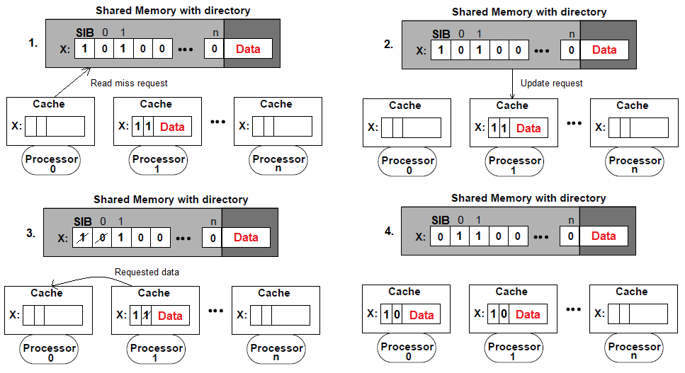
Full Map Directory
Read miss (S.I.B. = 1)
Notes:
In the case of a read miss, the requesting cache sends a read miss request to the memory. If the single inconsistent bit is cleared and there is no cache in the system storing the requested block of data, the memory will send the data to the cache. If the requested block is shared among many caches (the single inconsistent bit is cleared), one of the private cache will send the block of data to the requesting cache and the present bit will be set for this cache. The private bits stay cleared and the valid bits stay set for all caches sharing a copy of the block.
If the single inconsistent bit is set (only one CPU has write access to the data) and there is a read miss from one of the CPUs, the memory will send an update request to the single cache storing the requested block of data. The cache sends the data to the requesting cache, clear its private bit since the data will be shared to more than one local cache and the single inconsistent is cleared in the directory (see figure 3).

Slide 40
Full Map Directory
Write miss
  Requester sends write miss request to memory
  Memory sends invalidate signal to sharing caches
    Sharing caches sends ACK signal
  Memory updates directory state
  Requester has private access to data
Notes:
In the case that a write miss occurs from one of the CPUs (its valid bit is “0” or the data is not found), all entries in other caches sharing the data will be set to invalid. One the memory sent the invalidate signals, the invalidated caches will send acknowledgements to the memory. If the single inconsistent bit was set (only one cache has been invalidated), the invalidated cache will send the data to the memory to update the memory block as well. The directory’s presence bits are updated, the single inconsistent bit is set and the data is sent to the requesting cache. The valid and private bits of the cache entry for the requesting cache will both be set.

Slide 41
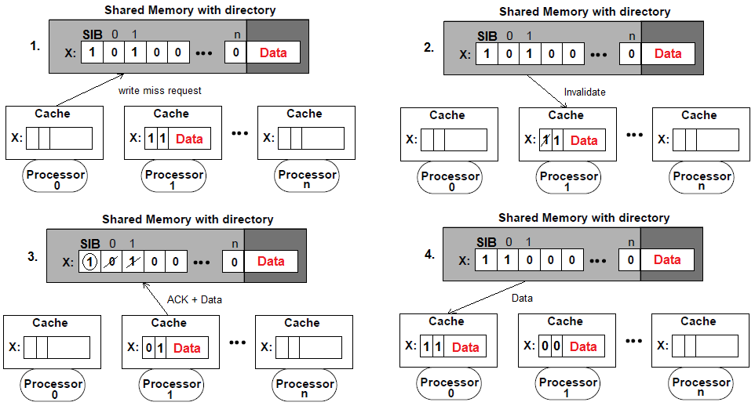
Full Map Directory
Write miss

Slide 42
Full Map Directory
Write hit
  Requester sends privacy request to memory
  Memory sends invalidate signals to other sharers
  Invalidated caches send ACK signal to memory
  Shared memory sends ACK signal to requester
  Requester CPU can write to data exclusively
Notes:
In the case of a write hit, if the privacy bit of the requesting CPU is set, the writing can be done locally without any communication with the memory (since the copy is already dirty). If the privacy bit is cleared, meaning that there might be other copy of the data to other caches, the requesting cache will need to send a privacy request signal to the memory. The memory will send invalidate signals to all caches that store a copy of the data. The invalidated caches will send acknowledgements to the memory, who will update the presence bits and the single inconsistent bit in the directory. The memory will then send an acknowledge signal to the requesting cache so it can set its private bit to “1”. The CPU then has the unique permission of writing to the data.

Slide 43
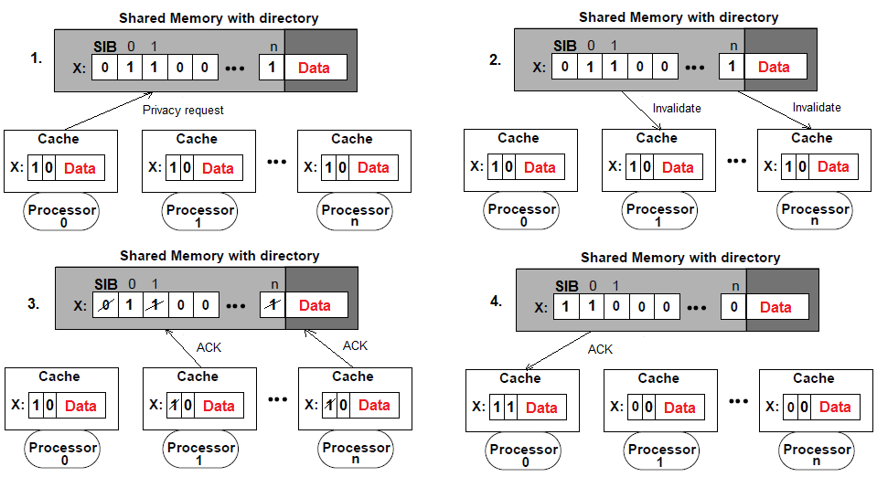
Full Map Directory
Write hit
Notes:
In the case of a write hit, if the privacy bit of the requesting CPU is set, the writing can be done locally without any communication with the memory (since the copy is already dirty). If the privacy bit is cleared, meaning that there might be other copy of the data to other caches, the requesting cache will need to send a privacy request signal to the memory. The memory will send invalidate signals to all caches that store a copy of the data. The invalidated caches will send acknowledgements to the memory, who will update the presence bits and the single inconsistent bit in the directory. The memory will then send an acknowledge signal to the requesting cache so it can set its private bit to “1”. The CPU then has the unique permission of writing to the data.

Slide 44
Limited Directory
Fixed number of pointers per directory entry regardless of the number of processors.
Restricting the number of simultaneously cached copies of any block should solve the directory size problem that might exist in full-map directories. .
Notes:
Full-map directories are hardly scalable, since the space used to store the bit vectors for each entry in the memory increases with the number of processors in a system. Limited directories solve this problem by setting a fixed directory size. Instead of using bit vectors to store if every cache has a copy of some block of data or not, the limited directory uses a reduced number of pointers regardless of the number of processors. This technique help reduce the size of the directory and the search time since a limited number of caches can store the same block at a same time.
Limited directories work almost the same as full-map directories. The major difference resides in the pointer replacement that takes place when there is no more room for new cache requests. Depending of the replacement policy chosen by the designer, one of the caches will need to be evicted in order to allow a requesting cache to store the block of data.

Slide 45
Limited Directory
Memory
Directory
X:
C0
C2
Data
Interconnection Network
X:
Data
X:
Data
Cache C0
Cache C1
Cache C2
Cache C3

Slide 46
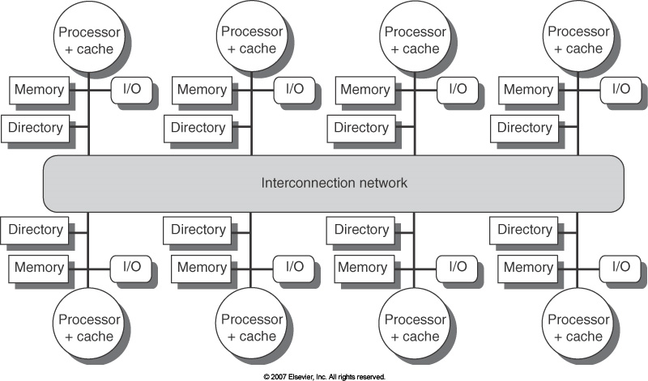
Distributed Directory
Distributed directory

Slide 47
Chained Directory
Chained directories emulate full-map by distributing the directory among the caches.
Solving the directory size problem without restricting the number of shared block copies.
Chained directories keep track of shared copies of a particular block by maintaining a chain of directory pointers.
Notes:
Chained directories are an example of distributed directory that work similar to the full-map directories as the number of processors that can share a copy of some block of data is not limited as in the limited directories. A chained directory makes use of a single or double linked list. Each directory entry stores a single pointer to a cache, who is pointing to the next cache storing the block of data and so on until the tail of the chained list. Different implementations of chained directories are used to manage the read and write requests such as the Scalable Coherent Interface (SCI) of the Stanford Distributed Directory (SDD) (not covered in this paper). In general, when a new cache makes a read request to the shared memory for some block of data, it becomes the new head of the list (the tail being the first cache reading the block). Only the head of the list has authority to invalidate other caches to have exclusive write access to data. If another cache needs to do a write request, it usually becomes the new head of the list.

Slide 48
Chained Directory
Memory
Directory
X:
C2
Data
Interconnection Network
X:
CT
Data
X:
C0
Data
Cache C0
Cache C1
Cache C2
Cache C3

Slide 49
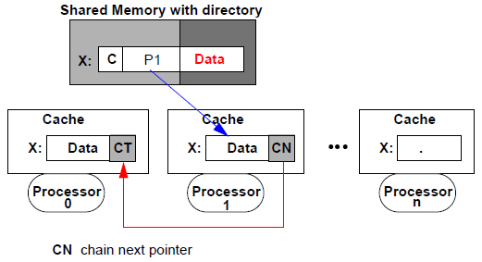
Chained Directory

Slide 50
Centralized Directory Invalidate
Invalidating signals and a pointer to the requesting processor are forwarded to all processors that have a copy of the block.
Each invalidated cache sends an acknowledgment to the requesting processor.
After the invalidation is complete, only the writing processor will have a cache with a copy of the block.

Slide 51
Write by P3
Memory
Directory
Write-reply
X:
1
0
1
0
Data
Invalidate &
requester
Invalidate &
requester
Write
inv-ack
X:
Data
X:
Data
Cache C0
Cache C1
Cache C2
Cache C3
inv-ack

Slide 52
Scalable Coherent Interface (SCI)
Doubly linked list of distributed directories.
Each cached block is entered into a list of processors sharing that block.
For every block address, the memory and cache entries have additional tag bits. Part of the memory tag identifies the first processor in the sharing list (the head). Part of each cache tag identifies the previous and following sharing list entries.

Slide 53
SCI Scenarios
Initially memory is in the uncached state and cached copies are invalid.
A read request is directed from a processor to the memory controller. The requested data is returned to the requester’s cache and its entry state is changed from invalid to the head state.
This changes the memory state from uncached to cached.

Slide 54
SCI Scenarios (Cont.)
When a new requester directs its read request to memory, the memory returns a pointer to the head.
A cache-to-cache read request (called Prepend) is sent from the requester to the head cache.
On receiving the request, the head cache sets its backward pointer to point to the requester’s cache.
The requested data is returned to the requester’s cache and its entry state is changed to the head state.

Slide 55
SCI – Sharing List Addition
Memory
Before
After
Memory
1) read
Cache C0
(head)
Cache C2
(Invalid)
Cache C0
(middle)
Cache C2
(head)
2) prepend

Slide 56
SCI Scenarios (Cont.)
The head of the list has the authority to purge other entries in the list to obtain an exclusive (read-write) entry.

Slide 57
SCI-- Head Purging Other Entries
Memory
Cache C0
(tail)
Cache C2
(middle)
Cache C3
(head)
Purge
Purge

Slide 58
Stanford Distributed Directory (SDD)
A singly linked list of distributed directories.
Similar to the SCI protocol, memory points to the head of the sharing list.
Each processor points only to its predecessor.
The sharing list additions and removals are handled different from the SCI protocol .

Slide 59
SDD Scenarios
On a read miss, a new requester sends a read-miss message to memory. The memory updates its head pointers to point to the requester and send a read-miss-forward signal to the old head. On receiving the request, the old head returns the requested data along with its address as a read-miss-reply. When the reply is received, at the requester’s cache, the data is copied and the pointer is made to point to the old head .

Slide 60
SDD– List Addition
Before
After
Memory
Memory
1) read
2) read- miss-
forward
Cache C0
(head)
Cache C2
(Invalid)
Cache C0
(middle)
Cache C2
(head)
3) read-miss-reply

Slide 61
SDD Scenarios (cont.)
On a write miss, a requester sends a write-miss message to memory. The memory updates its head pointers to point to the requester and sends a write-miss-forward signal to the old head. The old head invalidates itself, returns the requested data as a write-miss-reply-data signal, and send a write-miss-forward to the next cache in the list.

Slide 62
SDD Scenarios (cont.)
When the next cache receives the write-miss-forward signal, it invalidates itself and sends a write-miss-forward to the next cache in the list. When the write-miss-forward signal is received by the tail or by a cache that no longer has copy of the block, a write-miss-reply is sent to the requester. The write is complete when the requester receives both write-miss-reply-data and write-miss-reply.

Slide 63
SDD- Write Miss List Removal
Before
After
Memory
Memory
1) write
2) write miss-forward
Cache C0
(tail)
Cache C2
(head)
3) write miss-reply-data
Cache C3
(invalid)
Cache C3
(exclusive)
3) write miss-forward
4) write miss-reply

